Slide 1
Who created the “Science Factory”? and how is it run now?
Sanli Faez
Department of Physics / Debye Institute for Nanomaterials Science
@sanli

Slide 2
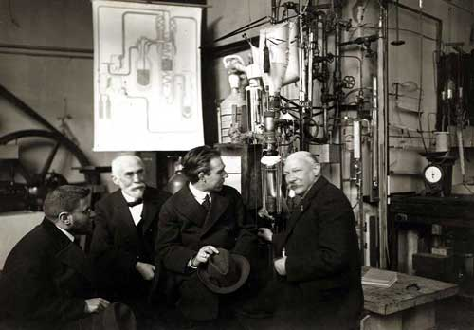
https://dbnl.org/tekst/delf006heik01_01/index.php

Slide 3
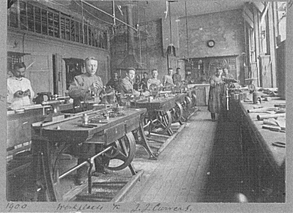
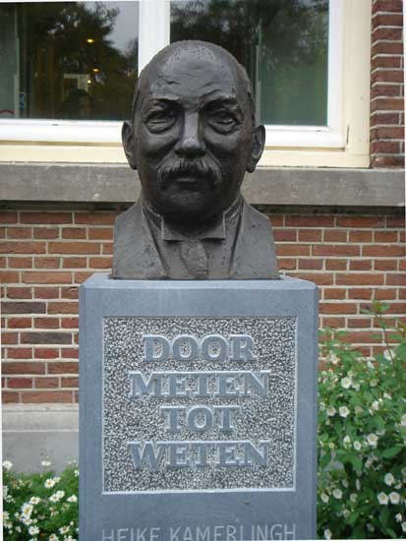
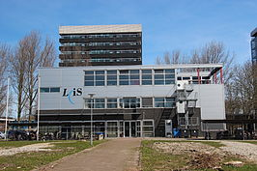
https://nl.wikipedia.org/wiki/Leidse_instrumentmakers_School

Slide 4
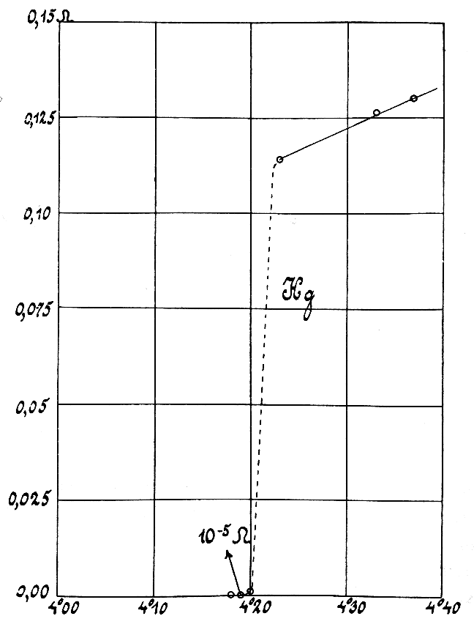
HKO’s success
Matthäus Krantz, How to get down to microkelvin?
Dirk van Delft and Peter Kas, The discovery of superconductivity
Physics Today 2010

Slide 5
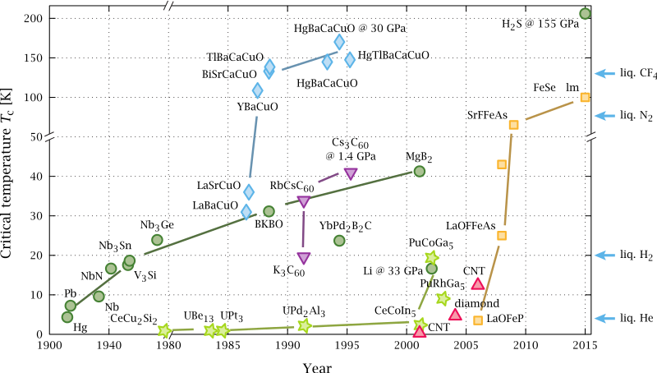
Timeline of superconductivity

Slide 6
HKO’s failure
Per F. Dahl, Historical Studies in the Physical Sciences, 1984
Onnes, Gerrit Flim, chief of the technical staff, and their coworkers Gilles Holst and Cornelius Dorsman performed the experiments. Onnes and Flim looked after the cryogenic apparatus in which the mercury was cooled, while Holst and Dorsman sat in a dark room 50 meters away, recording the resistance readings from the galvanometer.
Rudolf de Bruyn Ouboter, Scientific American 1997
The Discovery of Superconductivity
Jacobus De Nobel and Peter Lindenfeld
Physics Today 1996

Slide 7
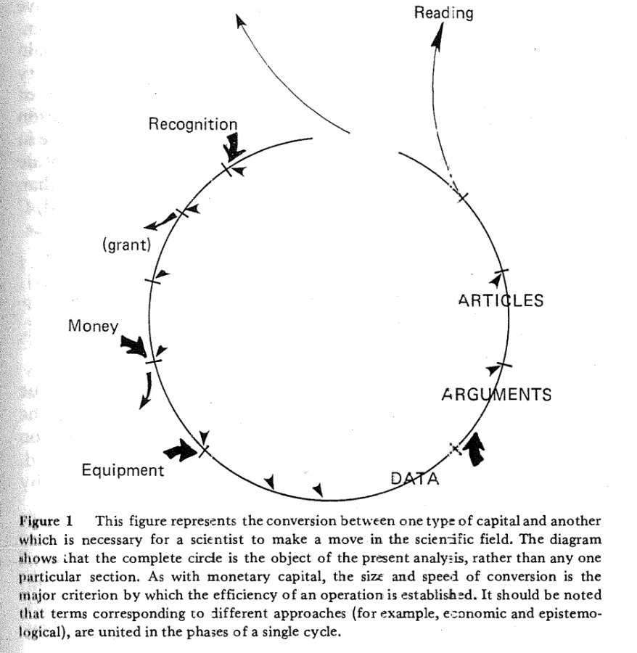

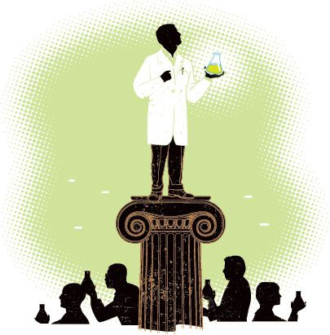
The Credibility Cycle
Credibility Network

Slide 8

CRediT Taxonomy
Conceptualization Data curation Formal Analysis Funding acquisition Investigation Methodology Project administration
Resources Software Supervision Validation Visualization Writing – original draft Writing – review & editing
https://casrai.org/credit/

Slide 9
How to flourish in a networked community?
https://github.com/nasa/Transform-to-Open-Science
https://github.com/UtrechtUniversity/awesome-utrecht-university

Slide 10
7 Suggestions
Understand community interactions
Have an admirable grand vision
Avoid the tyranny of structurelessness
Form/choose and altruistic team
You don’t have to start from scratch
Get in touch with users as early as possible
Choose and follow a good motto

Slide 11
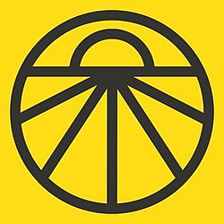
UED motto
people above projects, projects above people’s stuff

